Slide 1



UFO Sightings
Team Tenacious:
Abi Chambers
Alejandro Perez
Carlos De La Rosa
Ann Ly

Slide 2
Topic: UFO Sightings
We selected the topic of UFO sightings because of the perspective-broadening nature of the topic and the extensive data available. Sightings of unidentifiable objects have been reported as early as the 1940’s. The first well known UFO sighting occurred in 1947 near Mount Rainier in Washington (Shostak, S. (2023, April 21). Unidentified flying object. Britannica https://www.britannica.com/topic/unidentified-flying-object). The topic raises great questions about why so many people have reported similar sightings around the world.
LINKS TO SIMILAR EDAS
• https://www.kaggle.com/code/sagarsy2050/ufo-sightings/notebook
• https://towardsdatascience.com/are-we-alone-in-the-universe-data-analysis-and-data-visualization-of-ufosightings-with-r-42d0798679c3
• https://www.cs.ubc.ca/~tmm/courses/547-17F/projects/hayley-theodore/report.pdf
• https://www.kaggle.com/code/moosecat/world-ufo-sightings
• https://www.kaggle.com/code/brsdincer/meteorite-landings-analysis-all-eda-theory

Slide 3
UFO Sighting Dataset
Dataset: UFO Sightings around the world | Kaggle
This is a 13.71MB CSV dataset. It is comprised of eleven columns and over 80,000 rows. The data contained therein includes dates and times of the sightings spanning over 100 years, as well as the date the sighting was documented, city/state/country locations as well as latitude and longitude information of sightings, the shape of the unidentified object seen, the length of the encounter, and a text description.

Slide 4
Color Palette

Slide 5
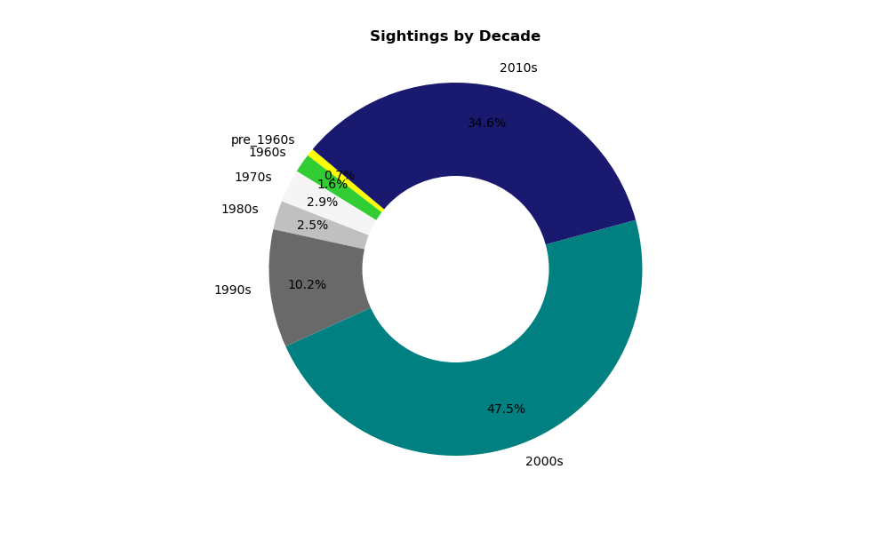

Slide 6
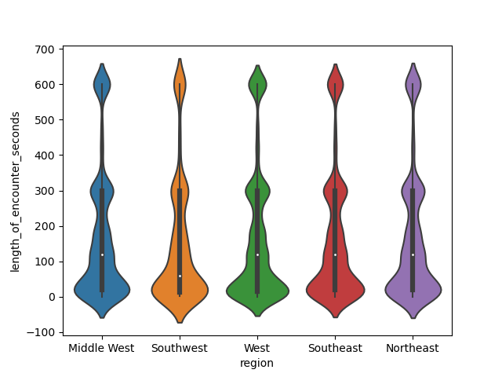

Slide 7
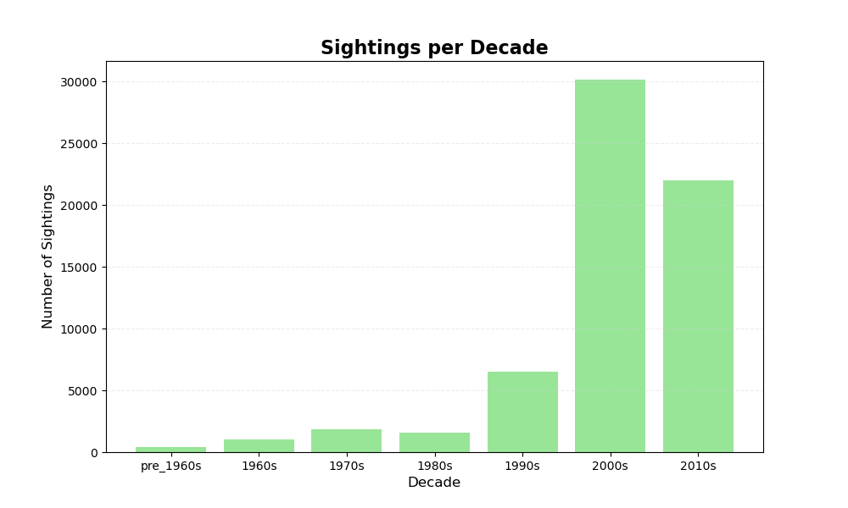

Slide 8
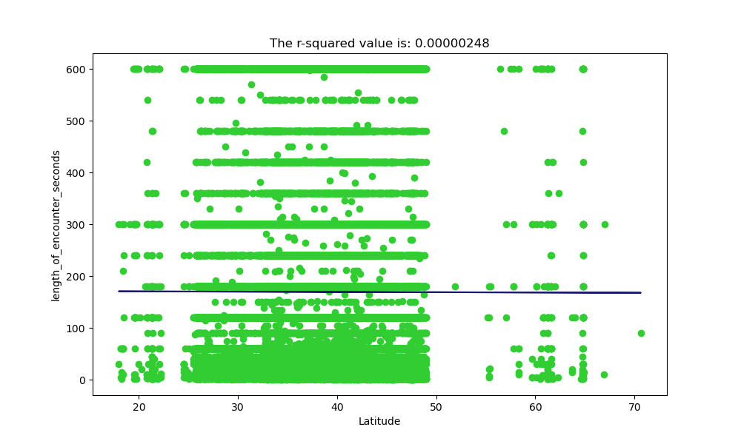

Slide 9
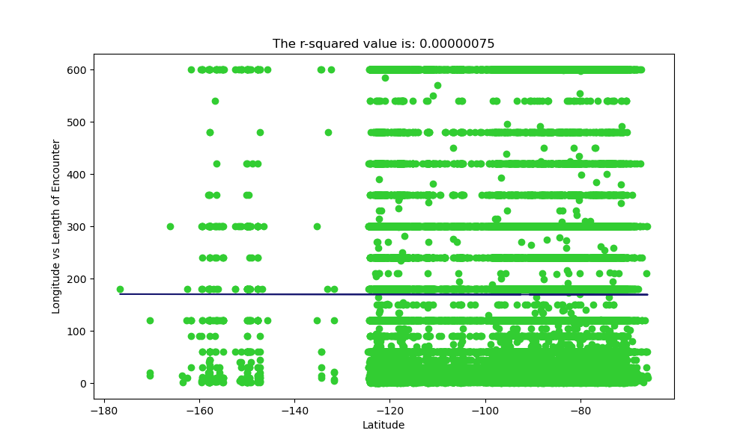

Slide 10
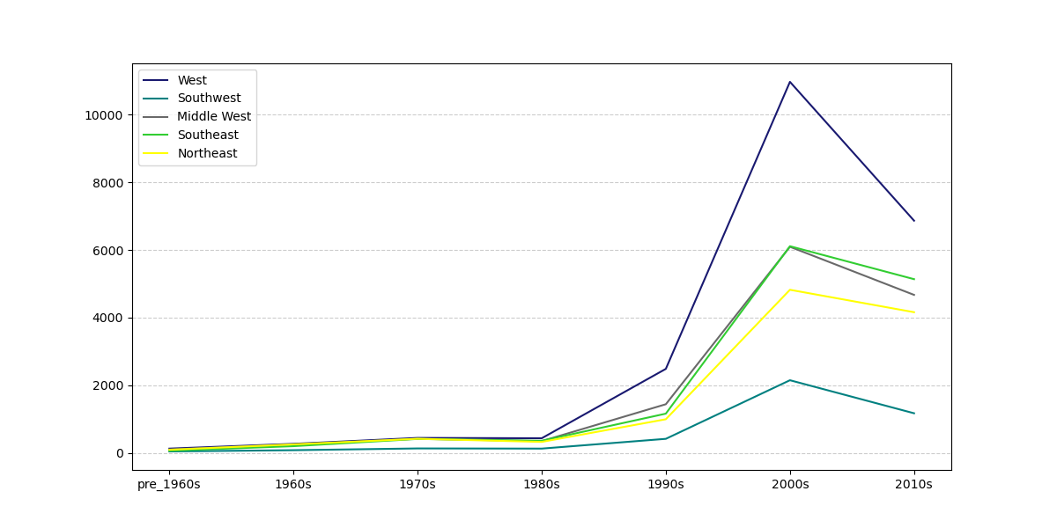

Slide 11
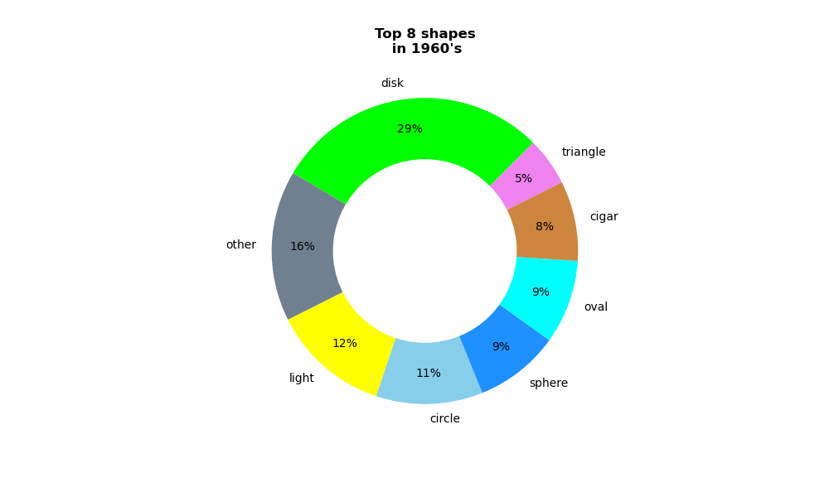
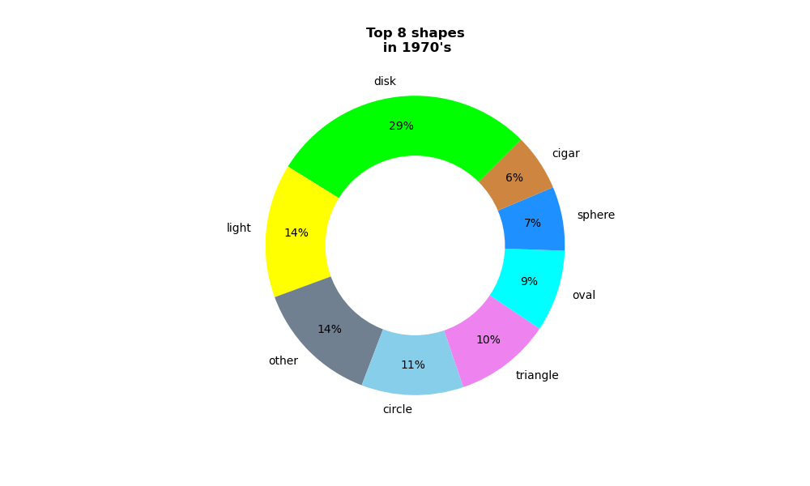
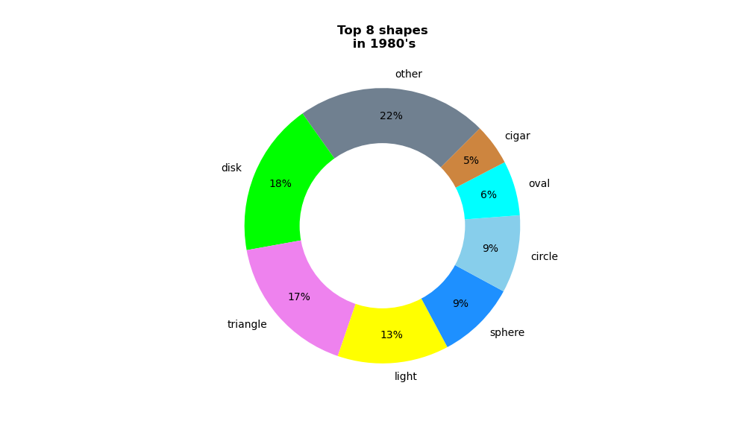
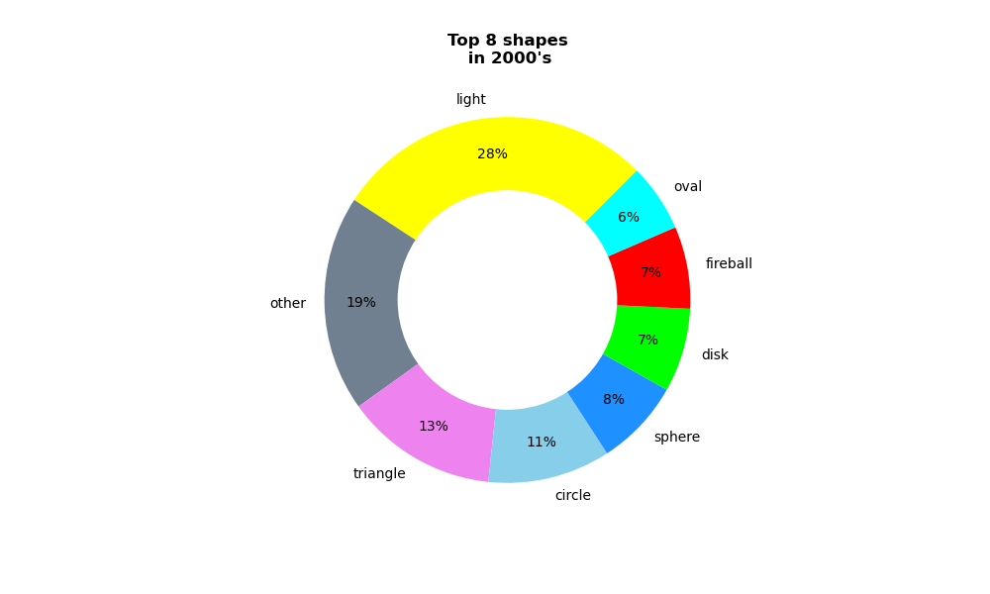
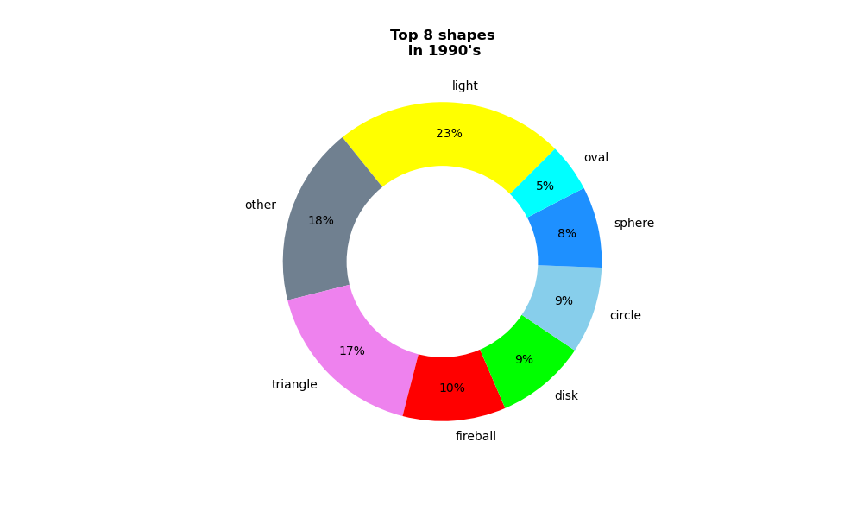
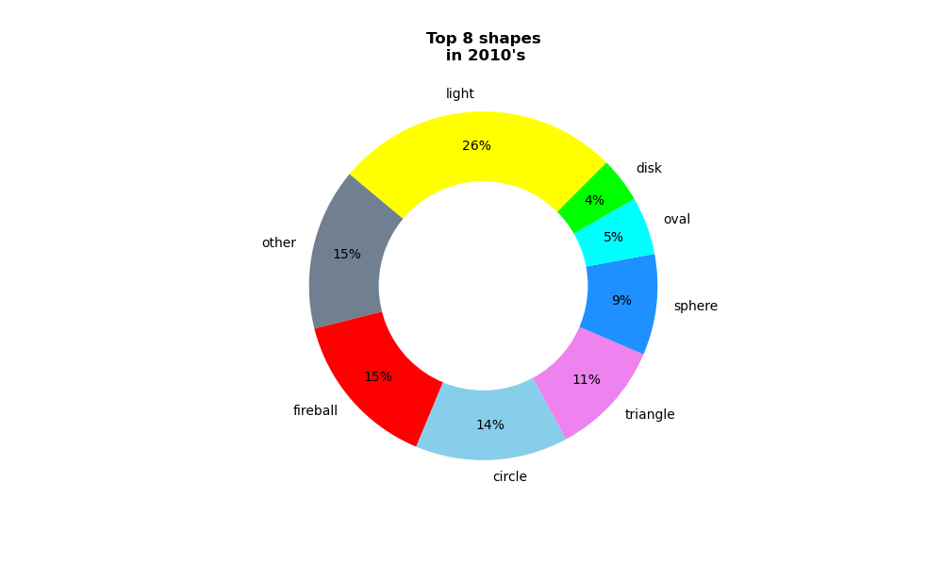

Slide 12
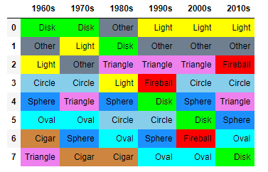

Slide 13
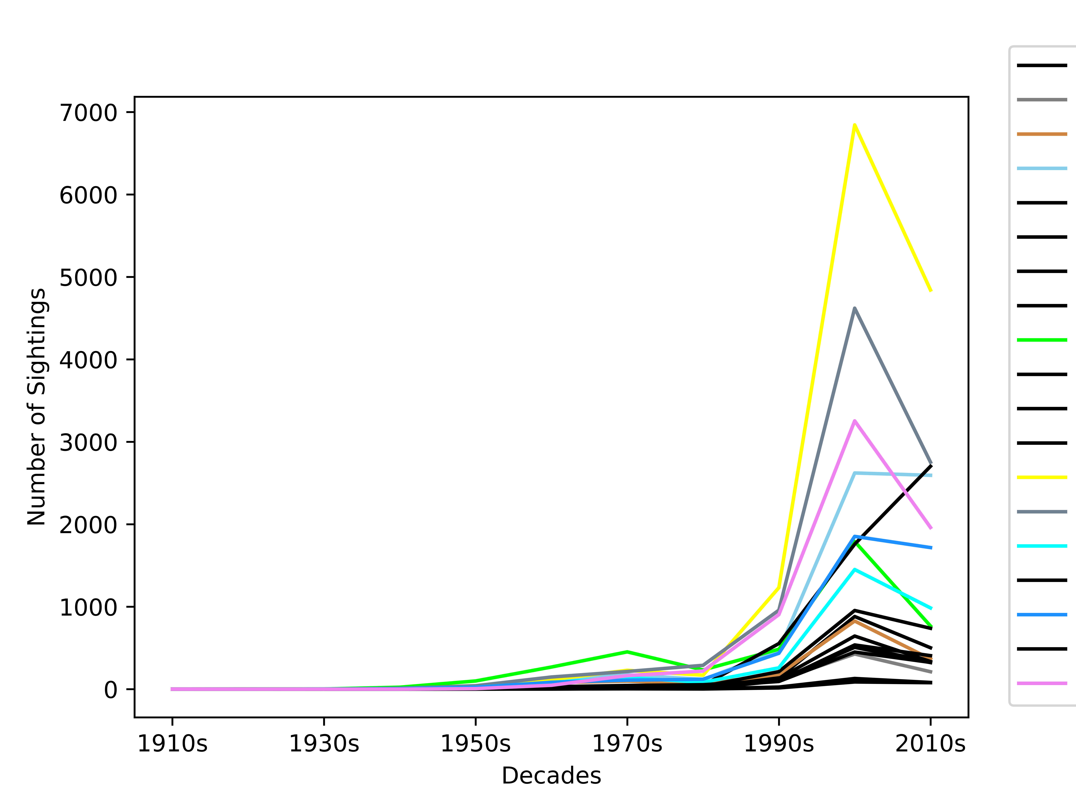

Slide 14
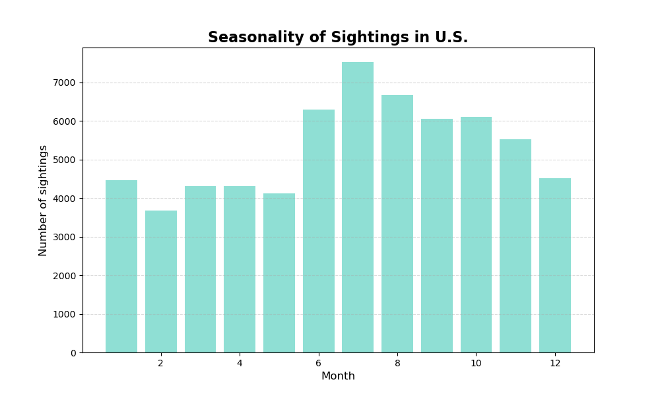

Slide 15

Relationships between sightings and particular times and dates ?
Seasonality of when sightings were most reported
Best months to witness a UFO sighting
Summer is the best time of the year

Slide 16
NUFORC data to determine which month people are most likely to see a UFO overhead. Overall, July topped the list with the most average monthly reports, followed by August, September, October, November
and June, in order.
Adams, R. D. (2022, July 27). July is top month for UFO sightings. here’s how likely you are to see one in Texas. Beaumont Enterprise. https://www.beaumontenterprise.com/news/article/UFO-sightings-by-state-best-places-to-see-UFO-17330047.php

Slide 17
